Slide 2
Presentation Plan
1) Evaluation Report – UCY Training
2) 2nd Meeting Feedback: state point
3) Quality Plan

Slide 3
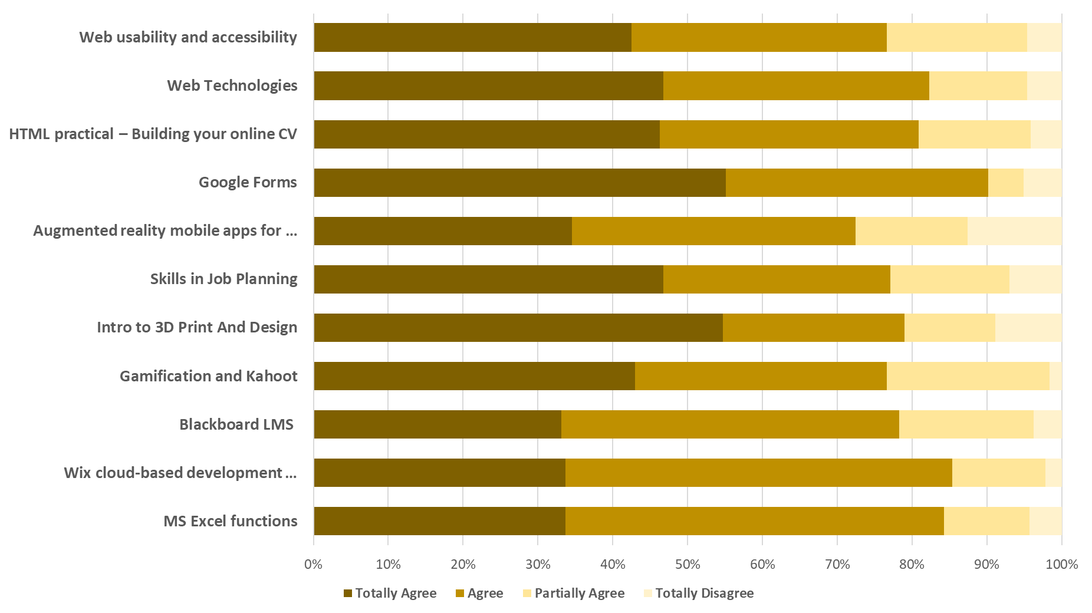
1) Evaluation Report – UCY Training

Slide 4
2) 2nd Meeting Feedback: state point
Tasks and responsability | Date
Training in UCY | 26/11/2019 To 28/11/219
Template to CV and typical question for interview | 1/10/2019
Done

Slide 5
2) 2nd Meeting Feedback: state point
Tasks and responsability | Date
Quality plan has to be approved by MU | 30/11/2019
Quality committee has to receive all information about the events related to the project from all partners in order to be able monitor the project. The name of a representative from the involved partner has to be sent to ISLA. | 10/09/2019
The sustainability plan has to be done by UJ and sent to MU and ISLA. | 30/11/2019
Not yet

Slide 6
2) 2nd Meeting Feedback: state point
Tasks and responsability | Date
Networking and list of stakeholders members | 30/09/2019
Report of the questionnaires and survey | 30/09/2019
Table of all dates and location of the training courses | 15/11/2019
Peer reviewing the training material | before training
BSBN equipment | 30/11/2019
Capacity Building Plan | 30/11/2019
Not sure

Slide 7
3) Quality Plan
Approval of Quality Plan
We would like to invite all members of Quality Committee to a brief reunion, after ISLA presentation.

